Slide 1
Monitoring and dashboarding in ICP
Robert Barron
Snr. Solution Engineer
Cloud Adoption, Garage Method, and Solution Engineering IBM Cloud

Slide 2
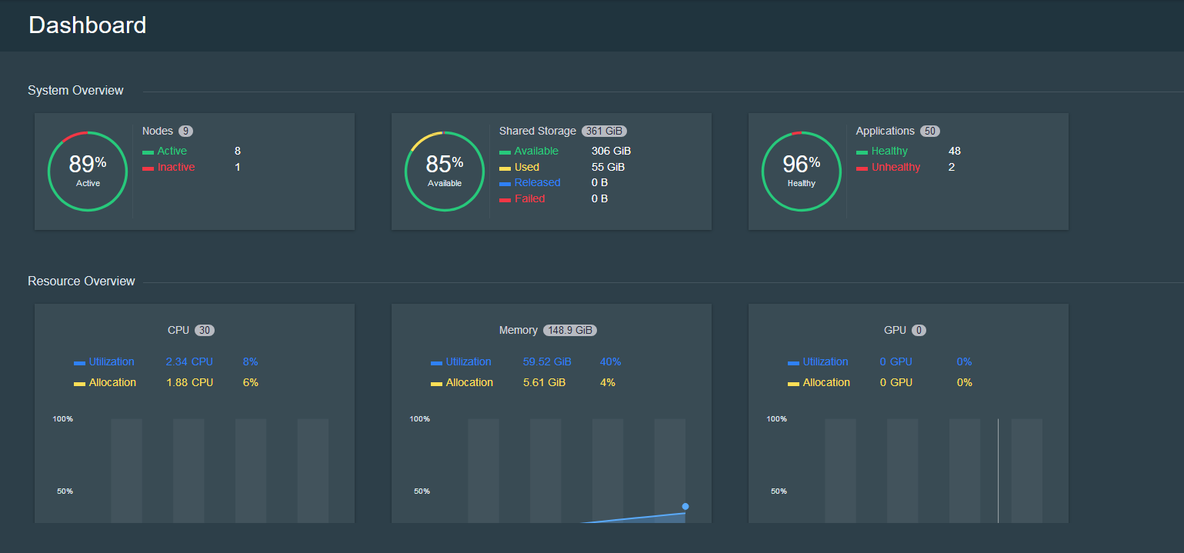
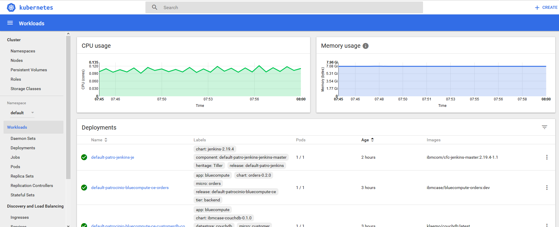
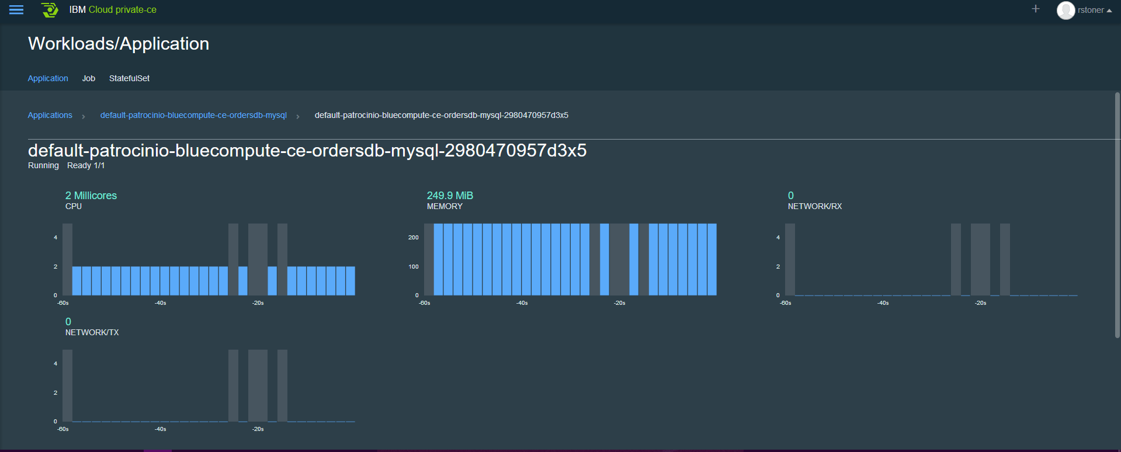
Monitoring an IBM Cloud Private Deployment
Within IBM Cloud Private there are several ways to view high level Key Performance Indicators
The ICP dashboard shows a high level overview of resource usage and status.
The Kubernetes Dashboard shows cpu and memory consumption of the full cluster and deployments
Within an application you can view performance of the pod.
We need to be able monitor and alert on Out of Bounds conditions for the applications and their infrastructure.

Slide 3
What is the base level of Monitoring/Logging in ICP?
In the October release, the ICP infrastructure and the two types of workloads will be monitored.
The ICP dashboard shows the status, metrics and log entries for all the workloads & Infrastructure.
An ELK stack collects logs from all the workloads & Infrastructure. Multiple ELK stacks are possible (but each log can only reside in one stack)
A Prometheus stack collects logs from the Kubernetes workload
Customizable Grafana and Kibana dashboards are available for use
Prometheus can send alerts to external system (email, webhooks)
Alerts
Extendable Dashboards and Alerts (Grafana/Kibana)
5
4
Default Dashboards
1
Prometheus
Kubernetes
ELK Stack
3
2
Heapster
Hosting Infrastructure (Virtual servers)

Slide 4
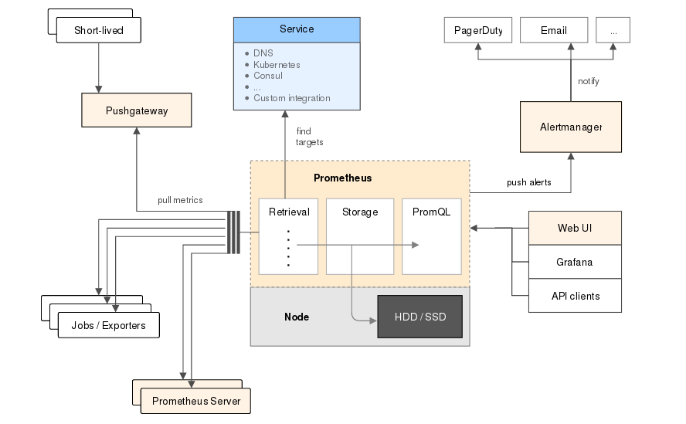
Prometheus
Prometheus is a Cloud Native Computing Foundation (CNCF) project, is a systems and service monitoring system. It collects metrics from configured targets at given intervals, evaluates rule expressions, displays the results, and can trigger alerts if some condition is observed to be true. https://prometheus.io/
Prometheus has several components for Time Series Data Collection, an Alert Manager and the Prometheus Server which scrapes and stores the data.

Slide 5
Grafana
Grafana is an open source metric analytics & visualization suite. It is most commonly used for visualizing time series data for infrastructure and application analytics but many use it in other domains including industrial sensors, home automation, weather, and process control.
https://grafana.com/grafana
While Prometheus has limited dashboarding capabilities of its own, regular display of metrics will be done using Grafana dashboards.
Prometheus and the Grafana Dashboards are installed togethers as applications into ICP

Slide 6
ELK stack or Elasticsearch Stack
The Elasticsearch stack (previously known as the ELK Stack) is a Log Management system which is composed of 3 layers:
Kibana is the extensible user interface for configuring and managing all aspects of the Elastic Stack.
Elasticsearch is a distributed, JSON-based search and analytics engine designed for horizontal scalability, maximum reliability, and easy management.
Logstash is a dynamic data collection pipeline with an extensible plugin ecosystem and strong Elasticsearch synergy.
Beats is a platform for lightweight shippers that send data from edge machines to Logstash and Elasticsearch.
Elasticseach is deployed automatically when ICP is installed (can be customized and/or opted-out of)

Slide 7
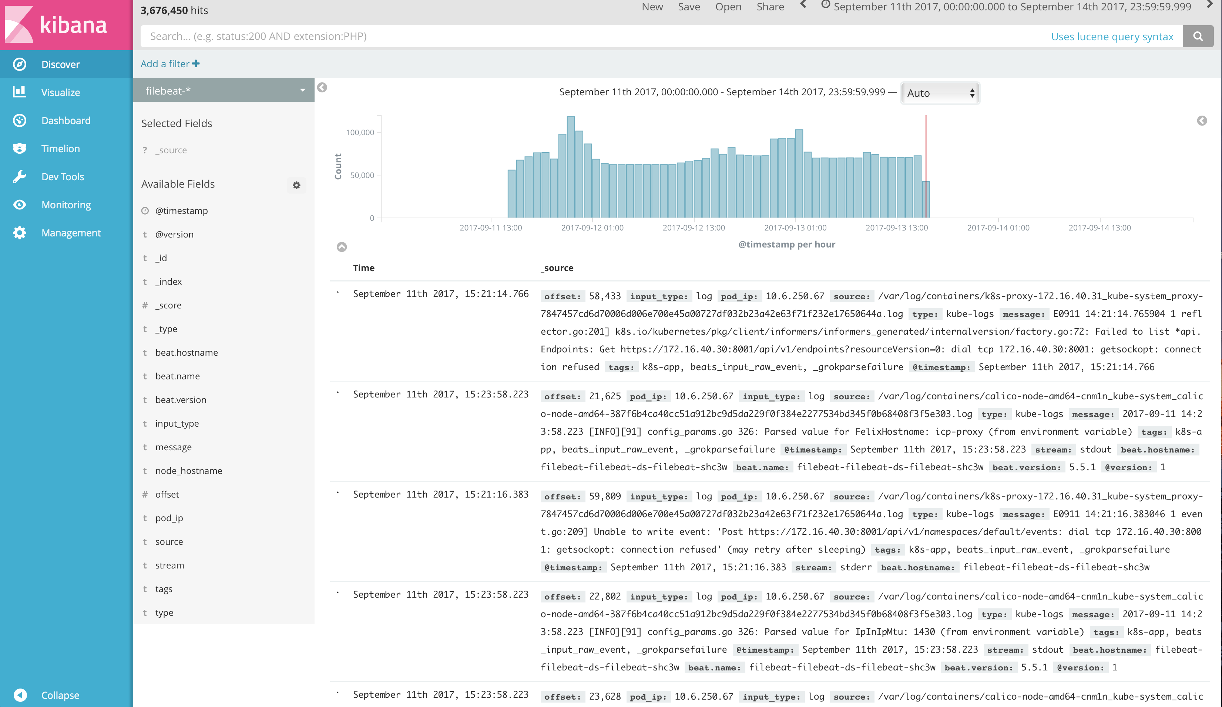
What are the advanced Logging capabilities for ICP? (Level 3)
External Elasticsearch / Log Analysis
Kubernetes
Default Elasticsearch Stack
Additional Elasticsearch Stack
Hosting Infrastructure (Virtual servers)

Slide 8
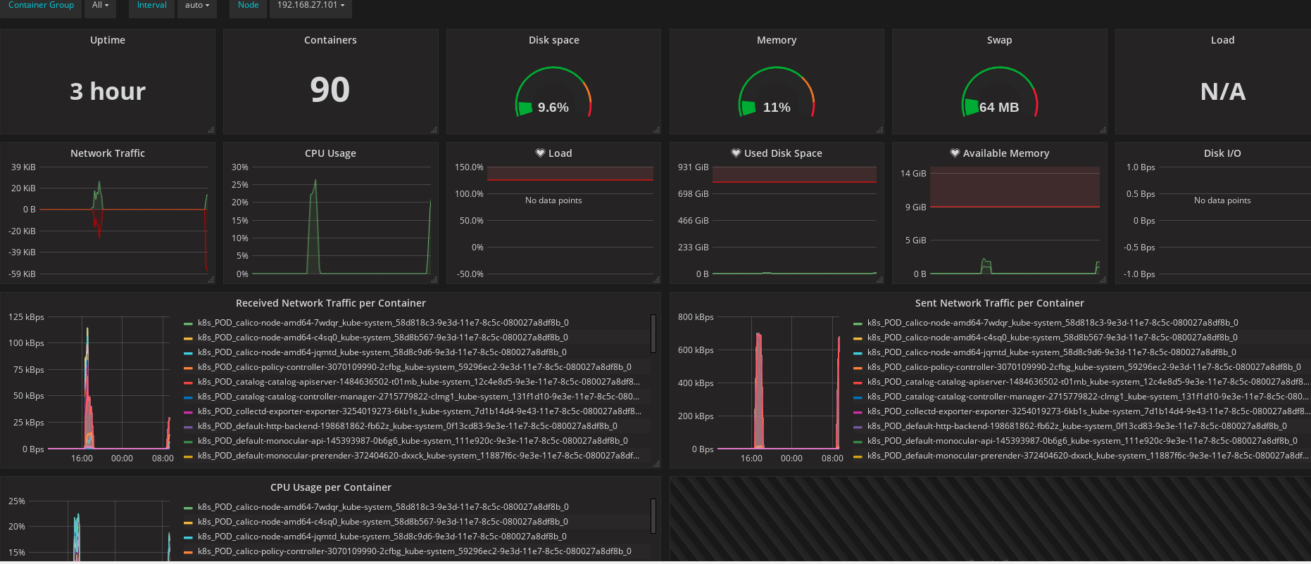
Custom Dashboards with Grafana
Pre-built dashboards are available here https://grafana.com/dashboards and can be imported to your Grafana application – the pre-built dashboards may require some “adjusting: for your environemtn.

Slide 9
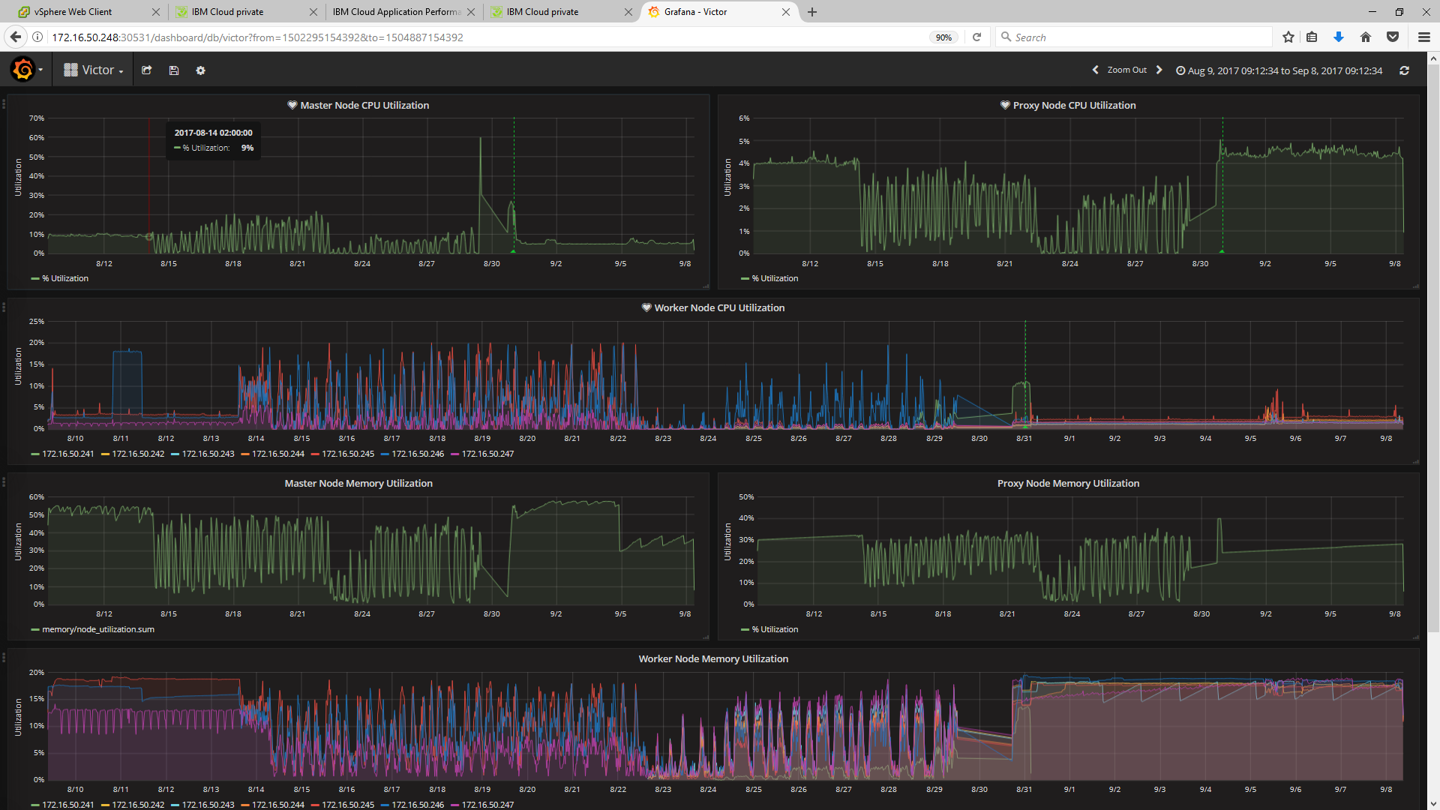
Custom Dashboards with Grafana
Victor, who is our Sight Reliability Engineer for CAMSE has built a custom dashboard for the ICP workload. Please see http://docs.grafana.org/guides/getting_started/ where you can quickly learn how to build custom dashboards.

Slide 10
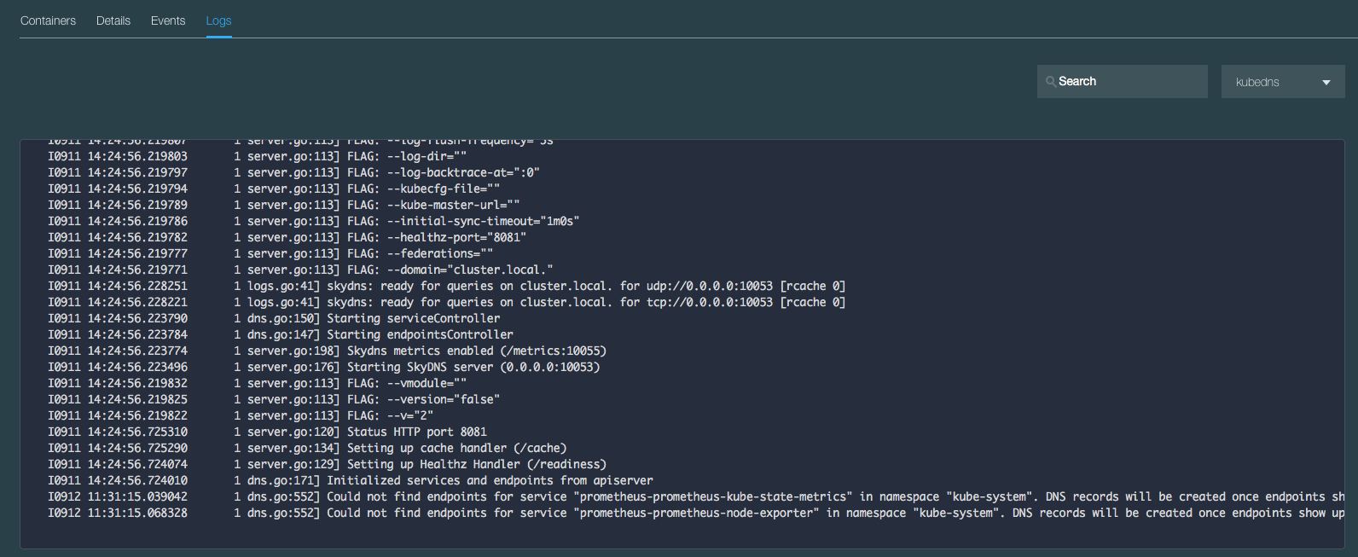
View Logs in Server UI
Example of looking at kube-dns logs:
In Server UI: Workloads → Applications
Select the application (eg. kube-dns) entry
In the lower section of the page
Select the application pod in the pod section
Scroll down and select the ‘Logs’ option

Slide 11

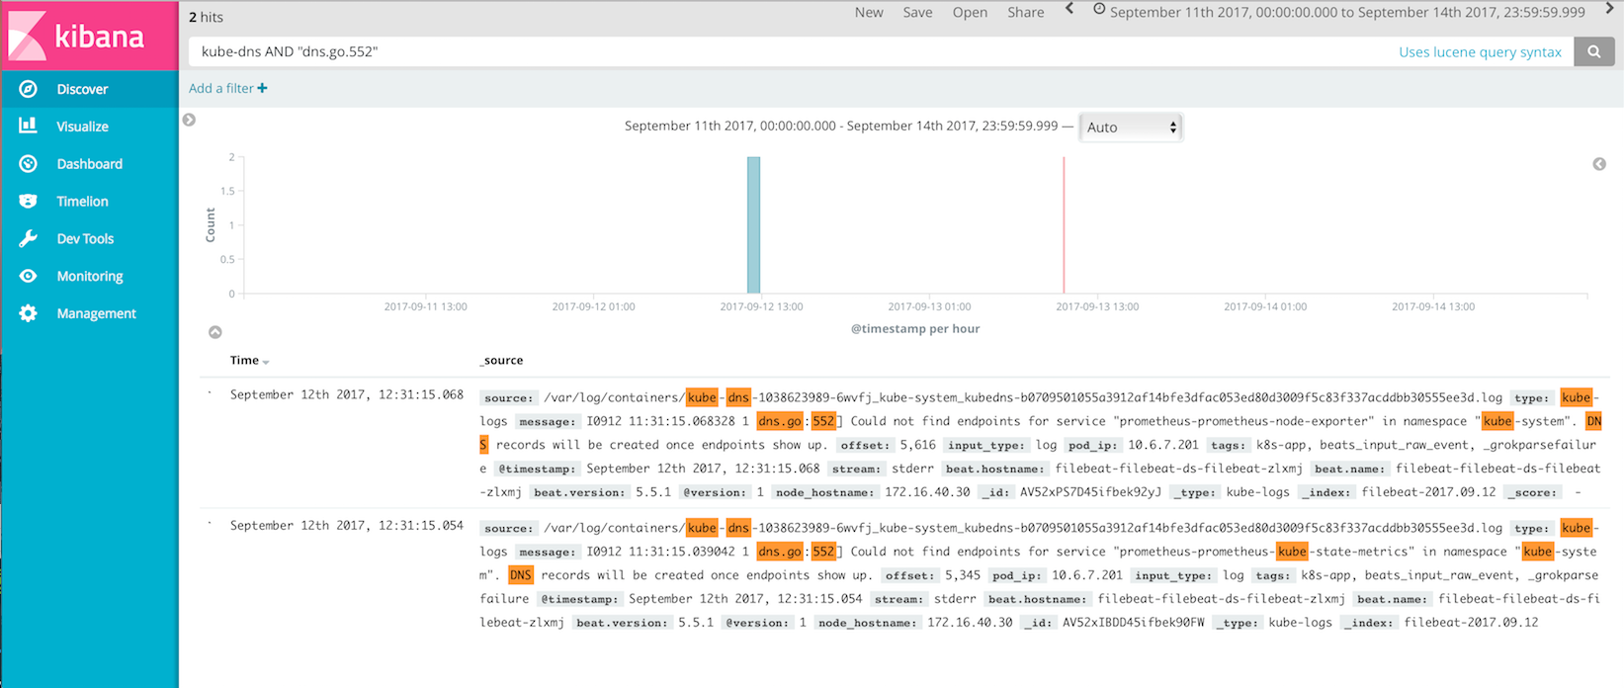
View Logs in Kibana
Use search filters to show log example entries shown in previous slide

Slide 12
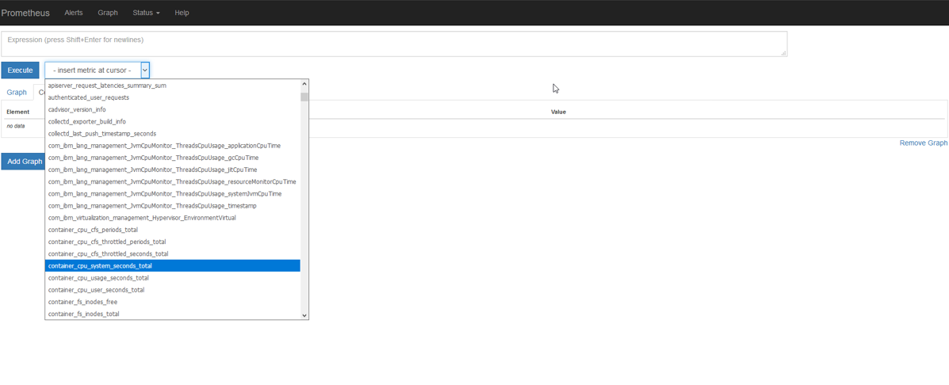
Prometheus Demo
Perform a query against the time series data, using the dropdown select the metric you would like to query, this example is using container_cpu_system_seconds total. Once the metric is selected, click on Execute to run the Query. You may also perform custom queries using the Expression area at the top of the screen.

Slide 13
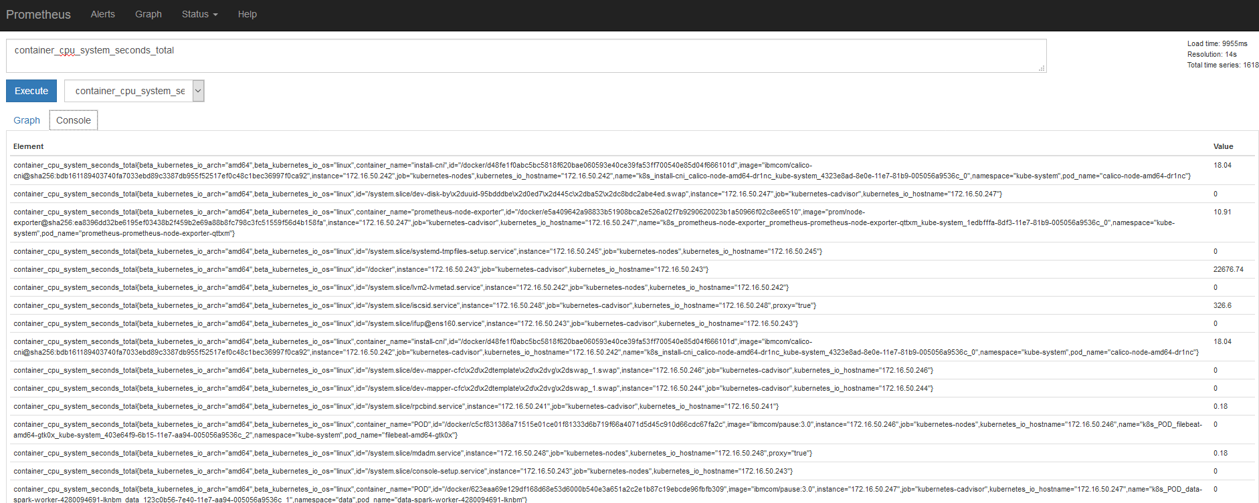
Prometheus Demo
The query results are then displayed on your console view:

Slide 14
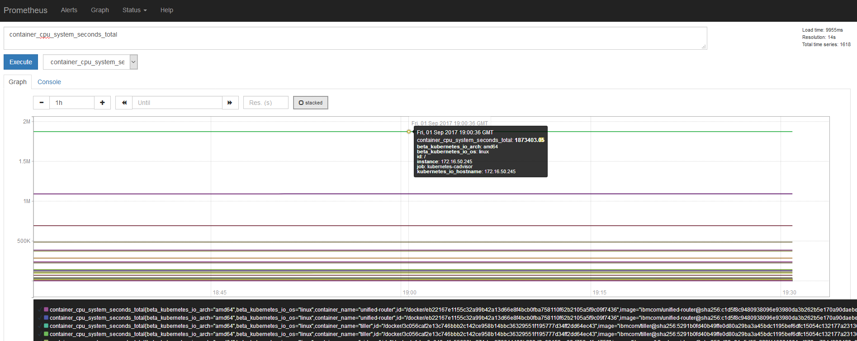
Prometheus Demo
Click the Graph button to graph the total cpu seconds:

Slide 15
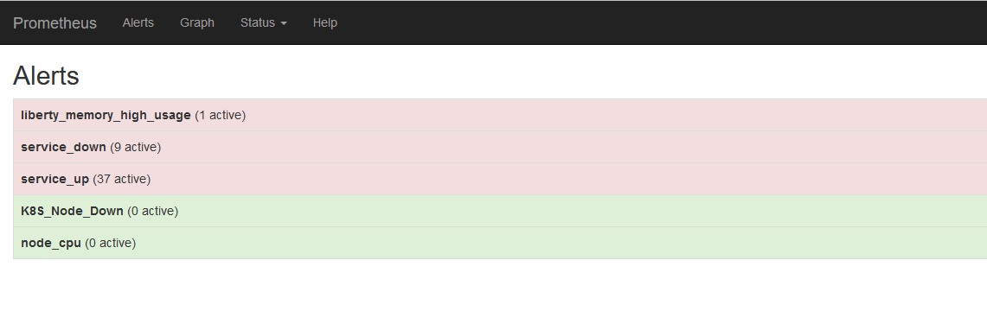
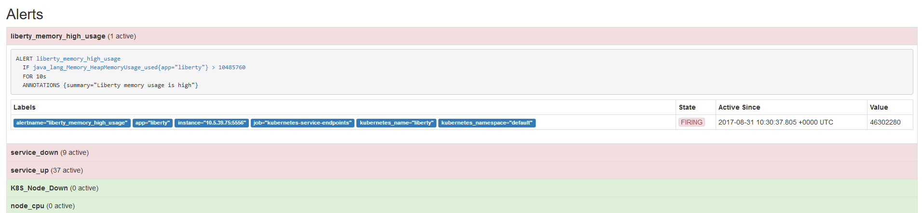
Prometheus Demo
There is an Alert summary view which displays a high level summary of open alerts:
Click on the alert group to see more information

Slide 16
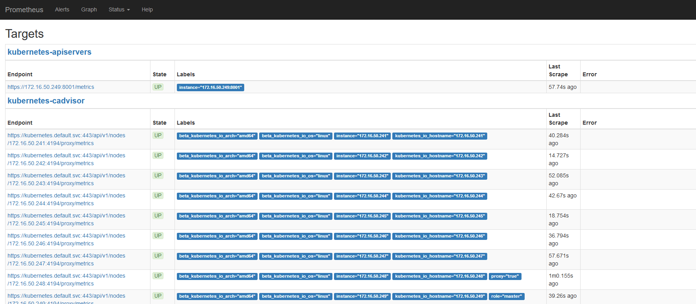
Prometheus Demo
A useful status is the Targets view, where you can see all the items that Prometheus is monitoring:

Slide 17
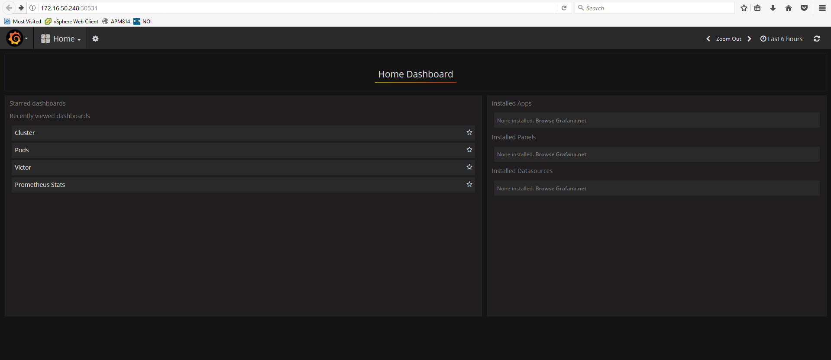
Grafana Demo
Grafana – Using Grafana provides to ability to view and leverage the data collected by Prometheus.

Slide 18
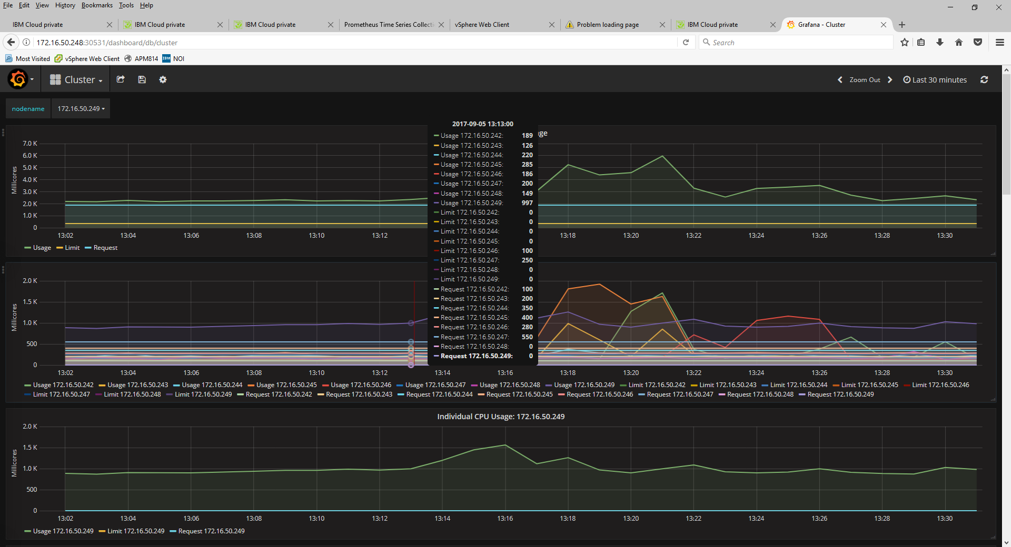
Grafana Demo
Below is the cluster view of the ICP deployment

Slide 19
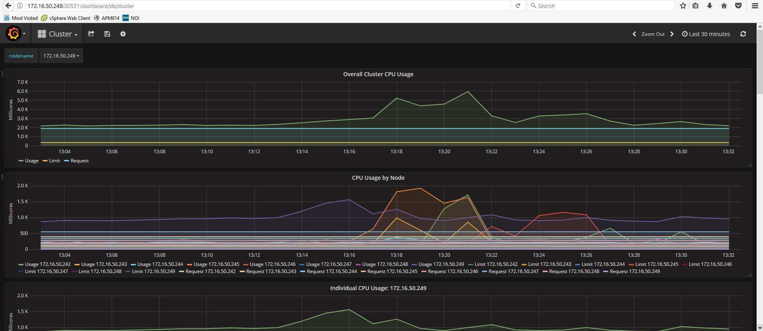
Grafana Demo
Below is the cluster view of the ICP deployment

Slide 20
Grafana Demo
Using your mouse to scroll over a view - a legend is provided with the cluster IP address an the metric value
Notes:
This top level view is quite “lengthy” be sure to scroll down to display the remaining metrics

Slide 21
Custom Dashboards with Grafana
Victor who is our Site Reliability Engineer for CAMSE has built a custom dashboard for the ICP workload.

Slide 22
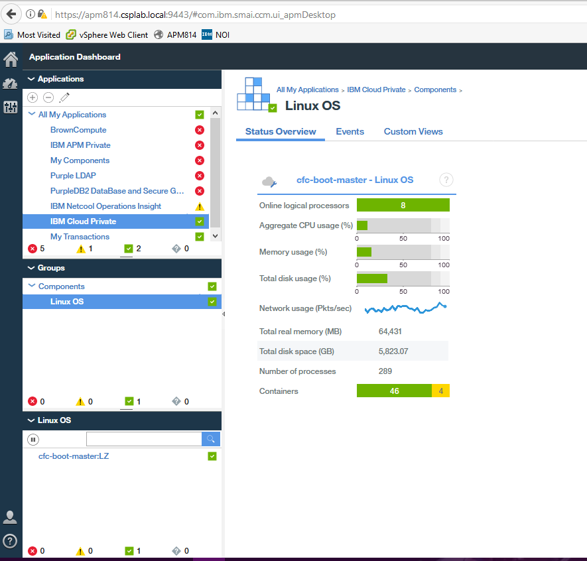
IBM Cloud private Performance Monitoring
Using IBMs APM to solution monitor resources in Icp
Existing IBM APM v8 customer can leverage the OS agent to monitor resource consumption of the ICP deployment.
No special configuration is required other then deploying ICP in an OS which is also supported by the OS Agent.
On the right is a high level summary view
of the OS agent

Slide 23
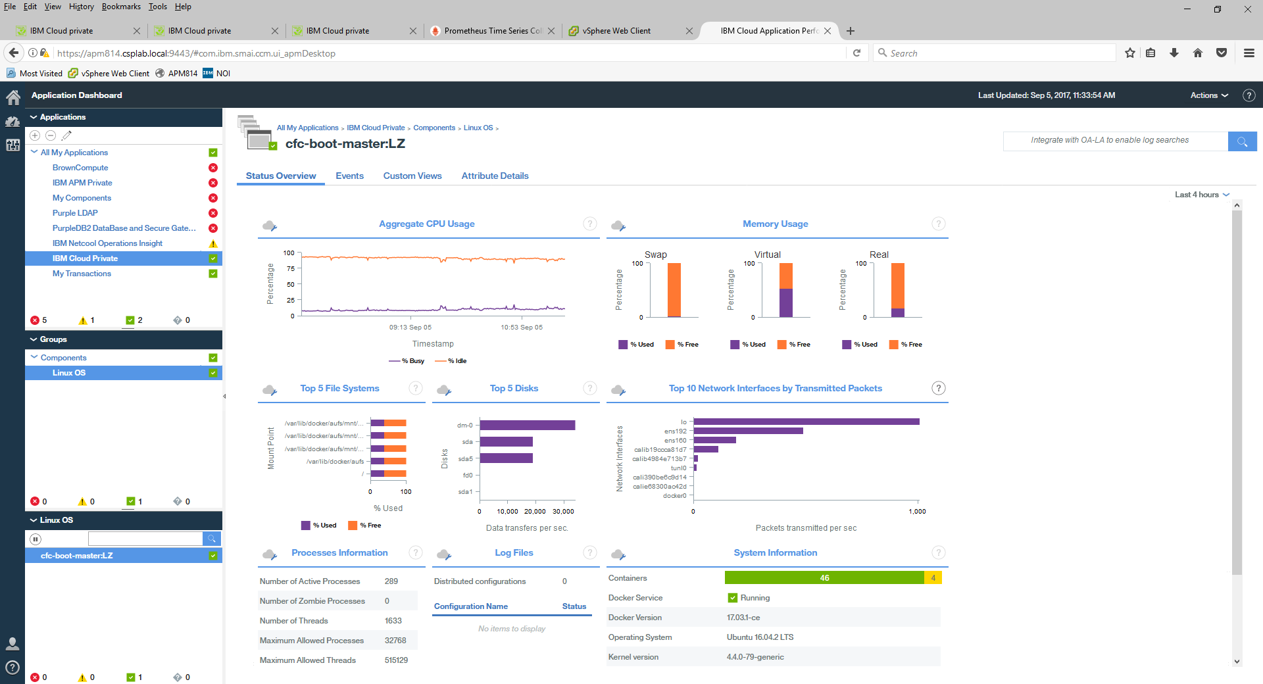
IBM Cloud private Performance Monitoring
Drill down into to OS agent, click anywhere within the status view, the lower right displays a summary of the containers running in the OS

Slide 24
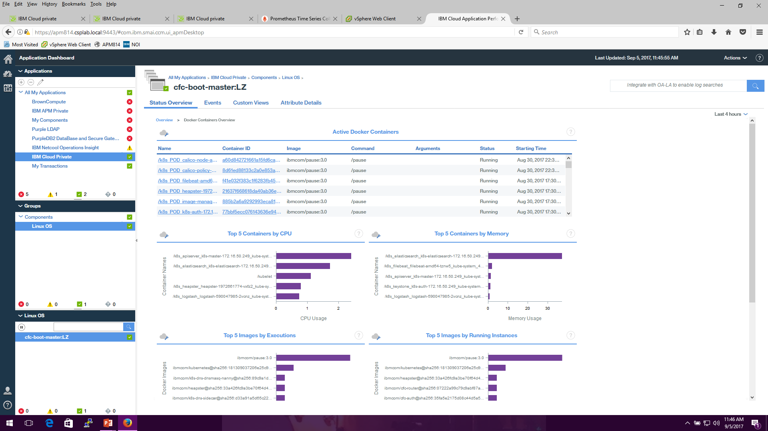
IBM Cloud private Performance Monitoring
Drill down into to a summary view of the containers , click anywhere within the System Information view
Notes:
Active Container View is sortabale by container id, command etc.

Slide 25
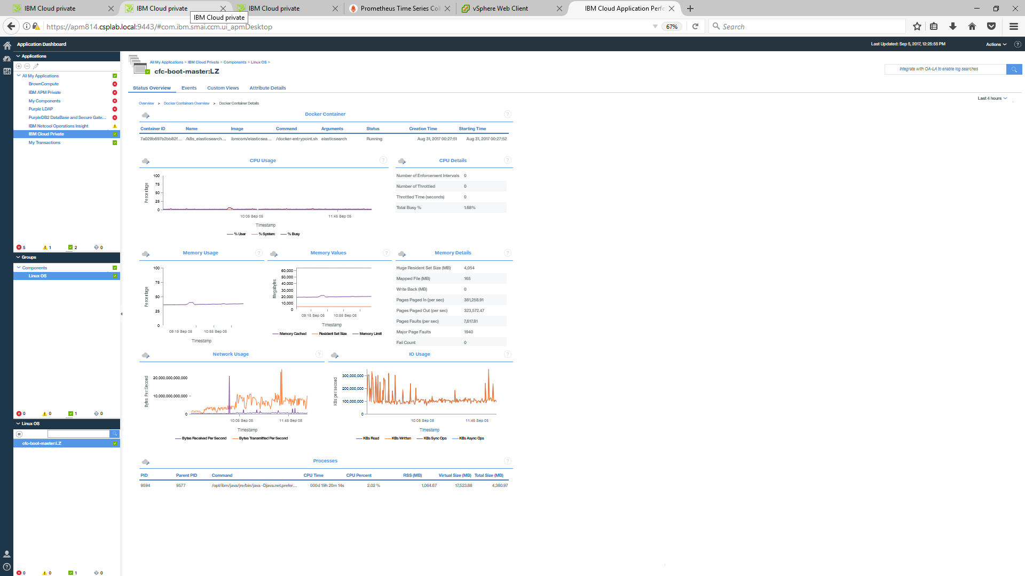
IBM Cloud private Performance Monitoring
Drill down to an individual container by clicking on the container in the active container view
Notes:
Here is view of the

Slide 26
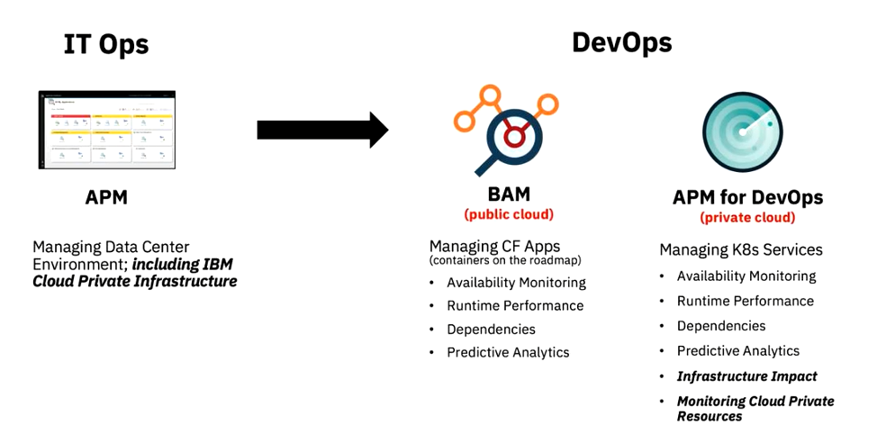

Slide 27
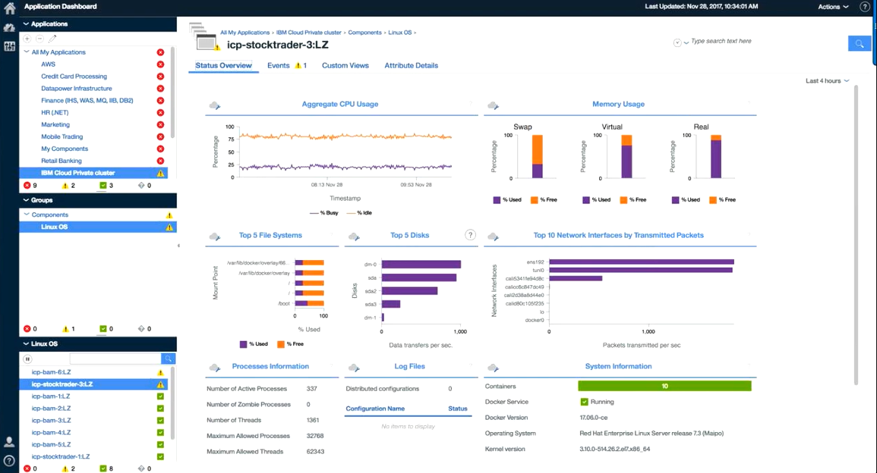

Slide 28
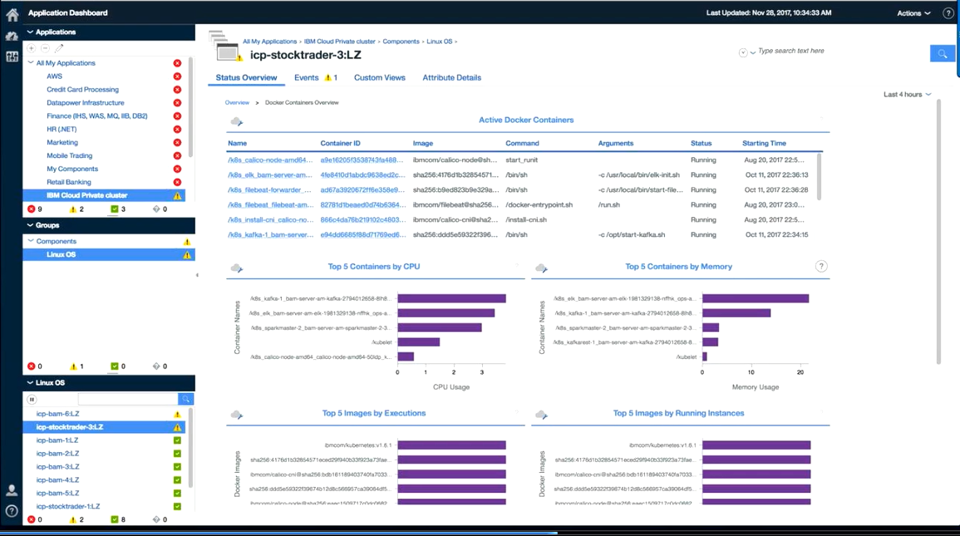

Slide 29
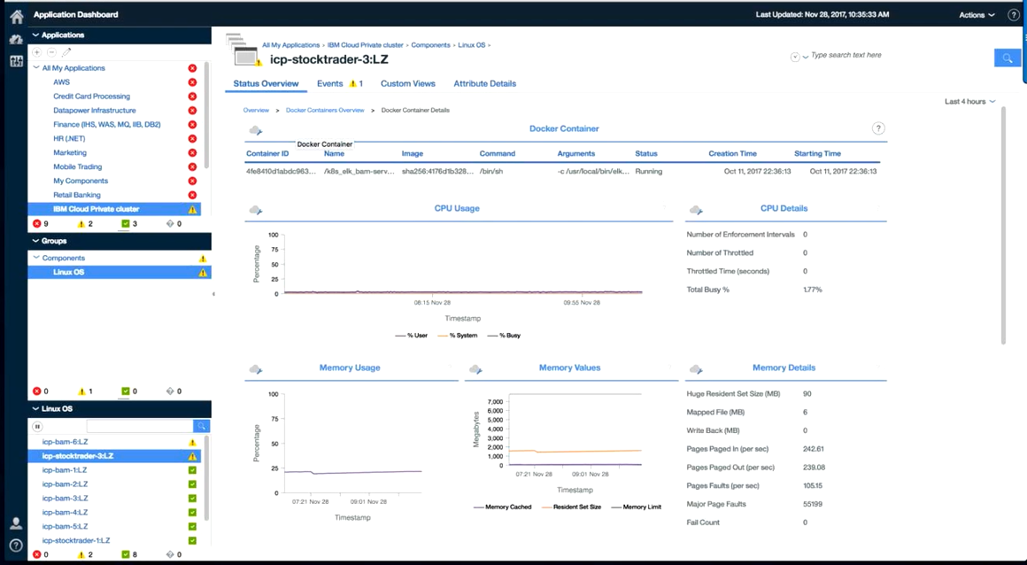

Slide 30
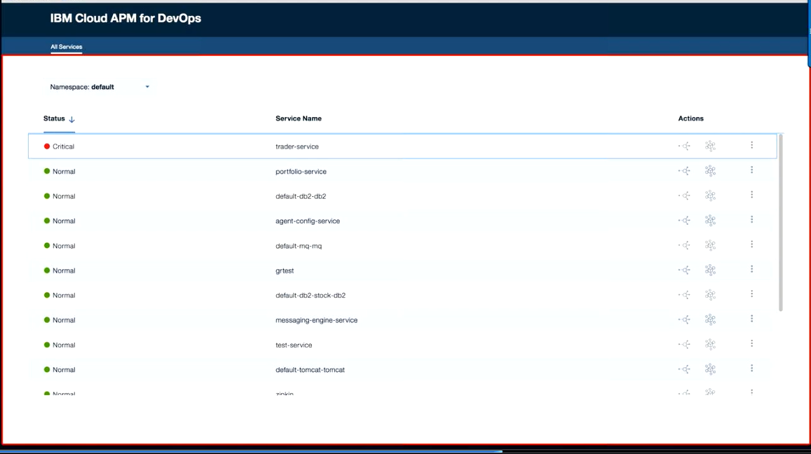

Slide 31
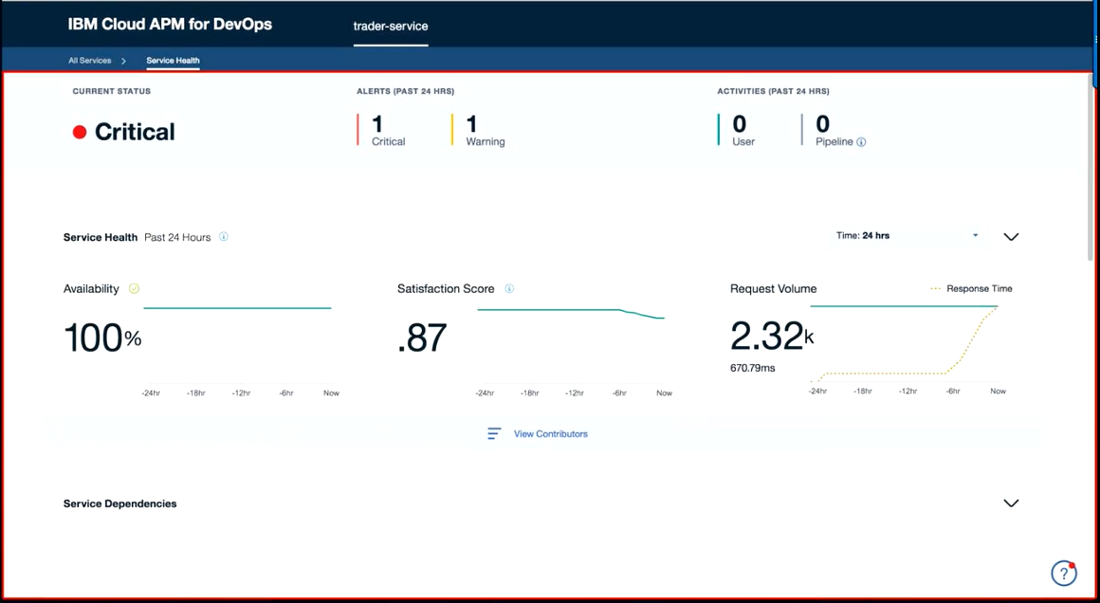

Slide 32
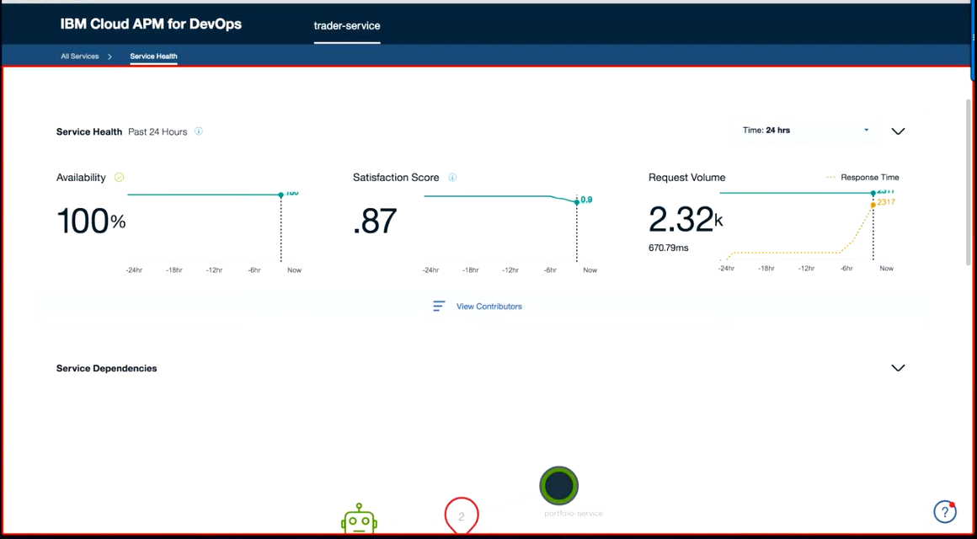

Slide 33
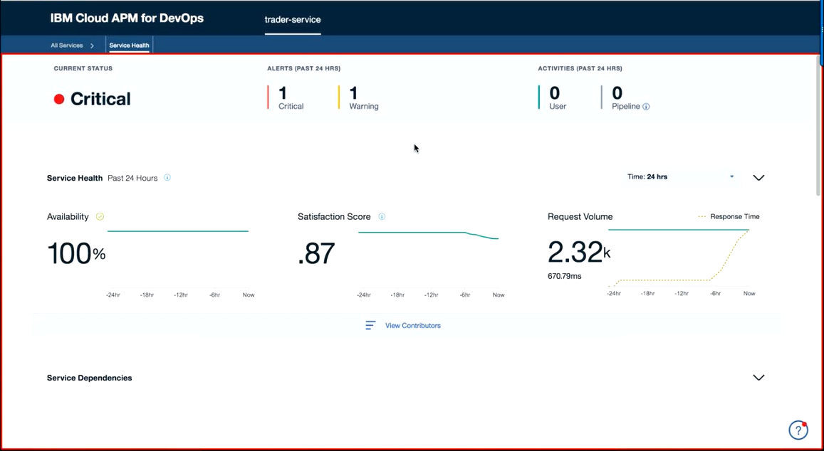

Slide 34
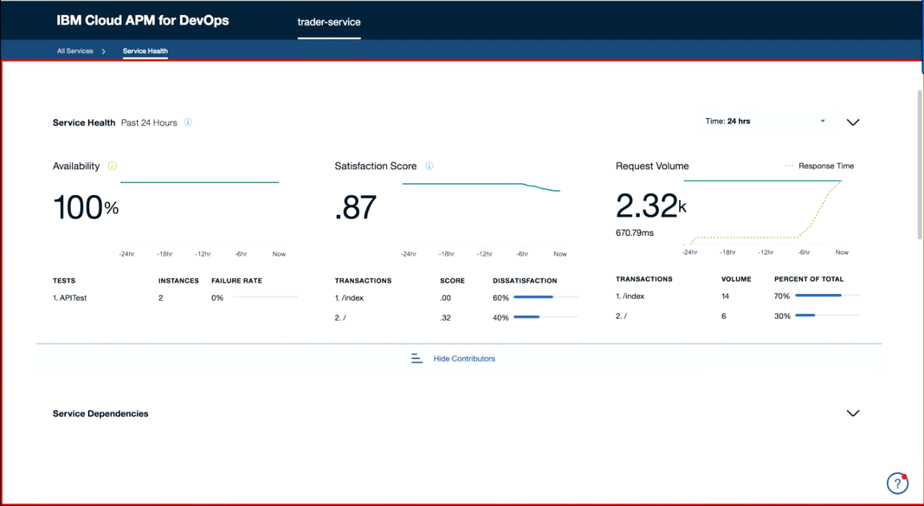

Slide 35
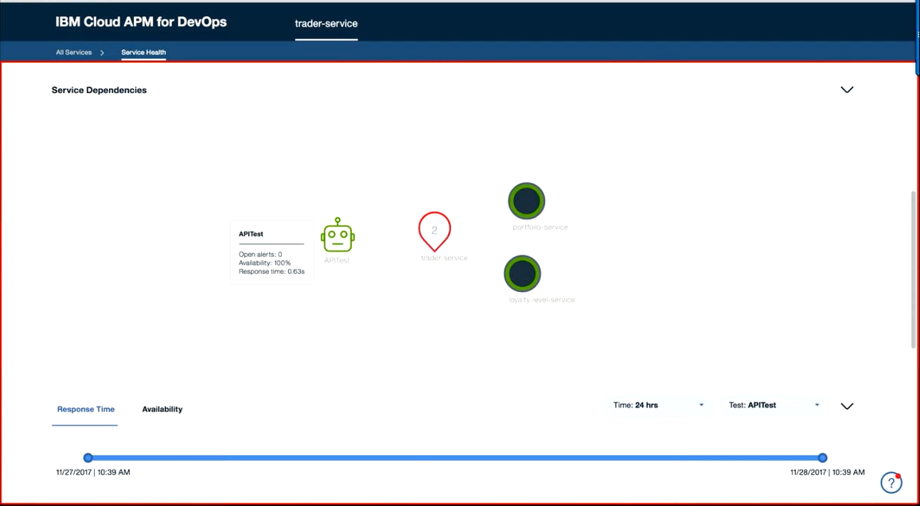

Slide 36
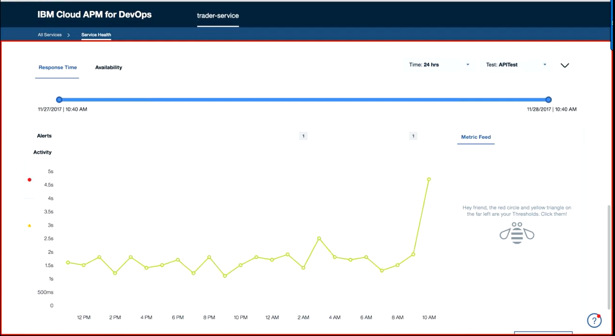

Slide 37
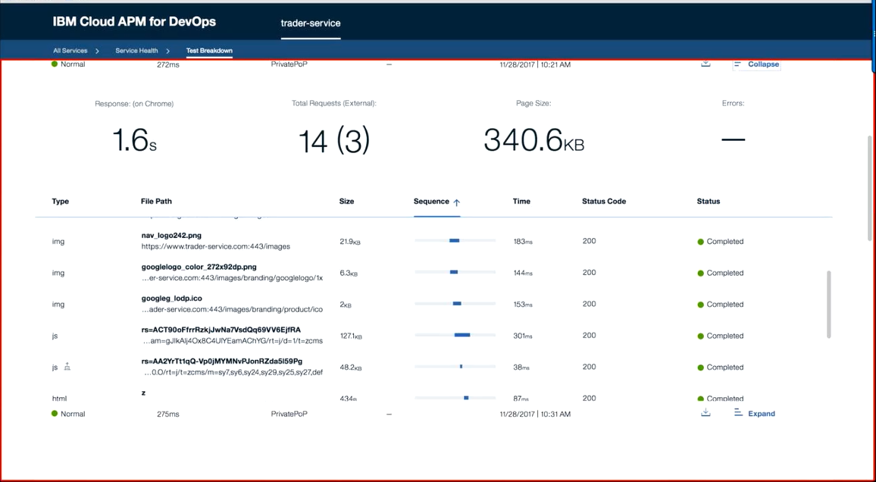

Slide 38
